Slide 1
Pytorch Conference 2026
AMD Skills
Daniel Holanda

Slide 2
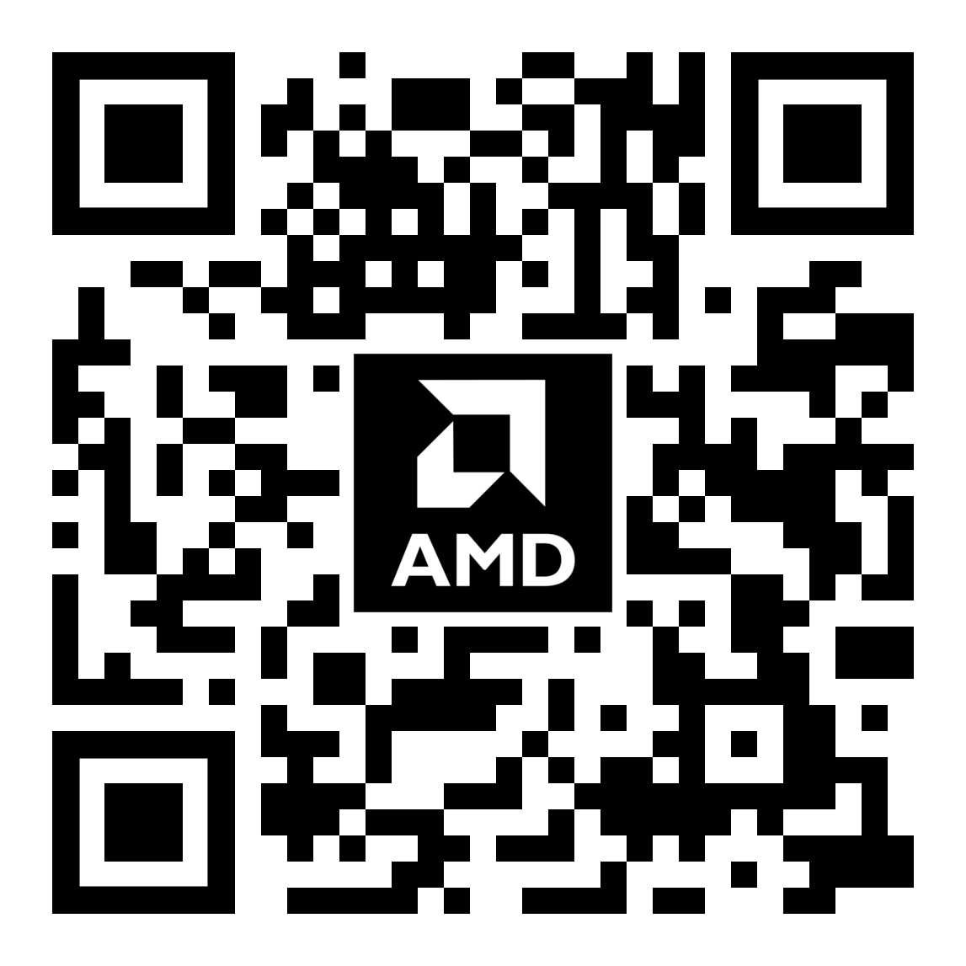
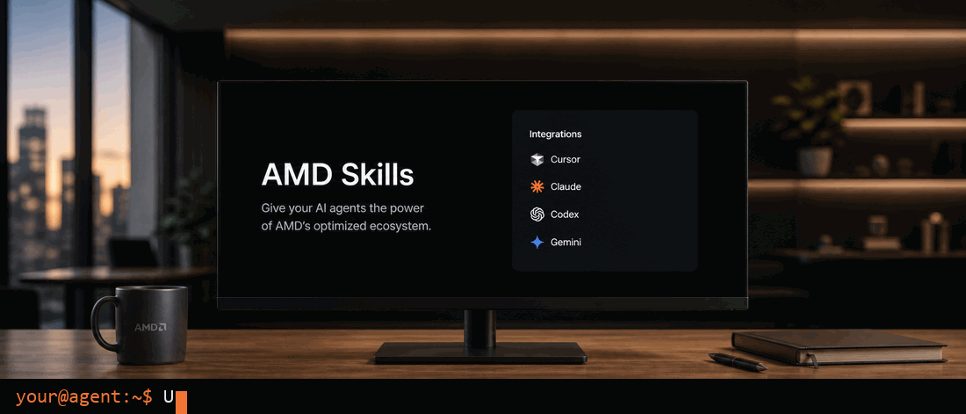

AMD Skills
github.com/amd/skills
Notes:
I want to start this presentation with a question:
When was the last time that your agent failed at a task you dind’t expect it to fail? or maybe it achieved the goal, but just took a really long time to achieve that goal?
That actually happens fairly often, right? Turns out that, some times, all you need to do is to steer your model towards the right direction to begin with.
Use tool A, not tool B. Make sure you don’t forget to use this flag, and oh, btw, if you are using this specific hardware, this is the fastest backend to use.

Slide 3
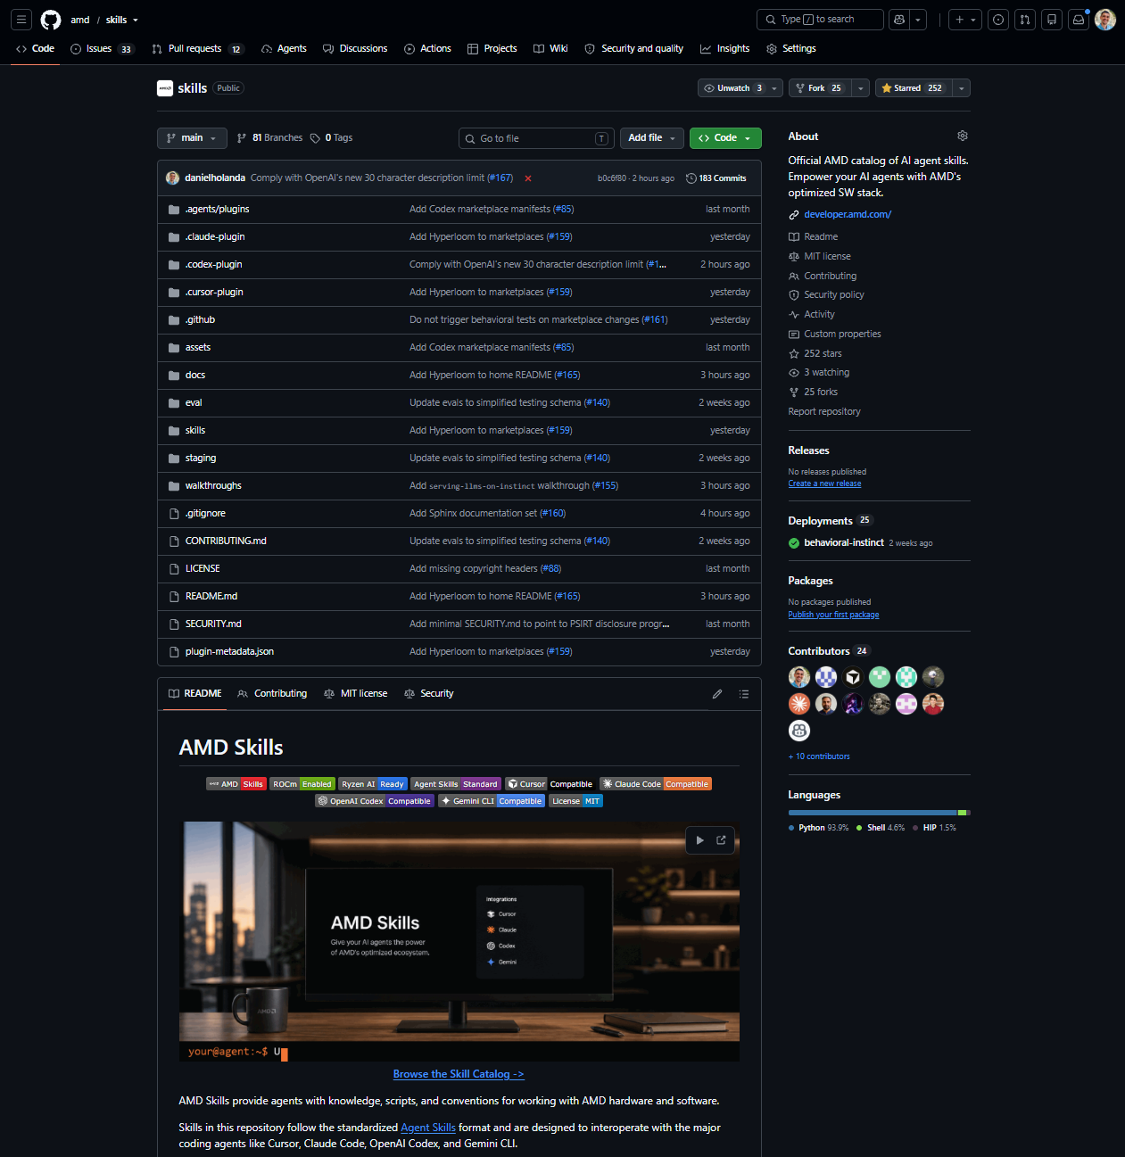
AMD Skills – Overview
EMPOWER YOUR AI AGENTS WITH AMD'S OPTIMIZED SW STACK
What is it?
Official AMD catalog of AI agent skills
Goal
Make AI agents significantly better
at assisting users with AMD technology
How to get access?
Available at
github.com/amd/skills
Quick Start
Open a terminal and run
npx skills add amd/skills
Star the repo ->
Notes:
This is why we created AMD Skills. To make your agents really good at assisting you with AMD technology. So you don’t have to worry about those details.
You ask your agent something, you provide it with the right skills, and it just works.
Inside of AMD we also worked really hard at making sure you have access to skills across our product portfolio, making sure that those skills are high quality, and making sure you can get access to it from a single cohesive place.

Slide 4

AMD Skills – What is in the catalog?
EMPOWER YOUR AI AGENTS WITH AMD'S OPTIMIZED SW STACK
Server Native Skills
vLLM Serving | Deploy LLM inference on AMD Instinct GPUs and EPYC CPUs
Hyperloom | Autonomously optimizes end-to-end LLM inference on AMD Instinct GPUs
MagPie | Benchmark vLLM/SGLang inference and evaluate GPU kernels
Tracelens | Turn PyTorch profiler traces into a prioritized performance report
Quark | Quantize LLMs with AMD Quark post-training quantization
Client Native and Cross-Stack Skills
Local AI Use | Route image generation, TTS, and STT through a local AI server.
Local AI App Integration | Integrate local AI into your own LLM app.
Lemonade Router Builder | Route LLM calls based on content, sensitivity, or required capabilities.
ROCm Doctor | Diagnose and fix common ROCm, HIP, PyTorch, and llama.cpp failures on AMD GPUs.
Under active expansion
Our catalog is expected to grow significantly
Notes:
: detect hardware (or onboard via AMD Developer Cloud), validate model fit, apply the right vLLM recipe, and launch a benchmarked endpoint. SGLang and engine/backend selection in later phases.

Slide 5






AMD Skills – Different ways of getting access
EMPOWER YOUR AI AGENTS WITH AMD'S OPTIMIZED SW STACK
Vercel NPX: the industry-standard catalog
MAIN CATALOG
All Skills
npx skills CLI
Terminal installer
skills.sh
Web marketplace
AMD Skills Repo
All skills aggregated. Every skill verified through CI/CD.
The complete set. Users pick individual skills; Works with all agents. Command: npx skills add amd/skills
Plugin Marketplaces
Curated bundle
SHOWCASE CATALOGS
SKILLS SOURCE
Claude Code
Plugin marketplace
Cursor
Plugin marketplace
Codex
Plugin marketplace
Cherrypicked skills. Same selection across all agents, built from the same source.

Slide 6
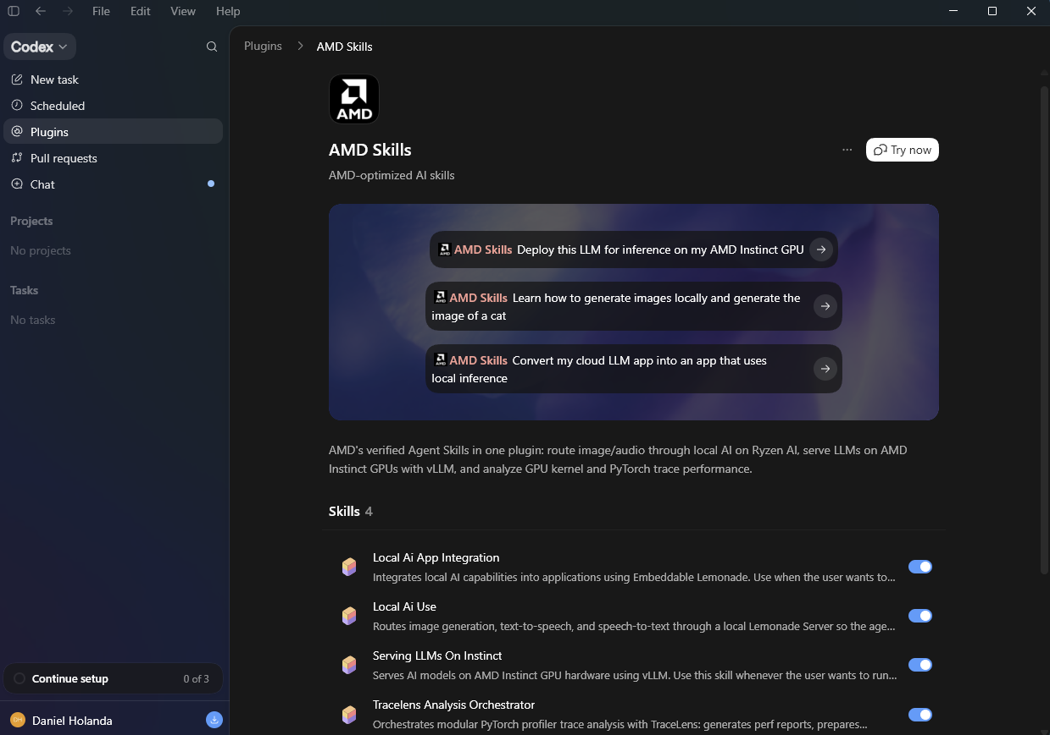
AMD Skills – Installing on Codex
EMPOWER YOUR AI AGENTS WITH AMD'S OPTIMIZED SW STACK
Available natively on the Codex app under Plugins. Click Try now to get started.

Slide 7
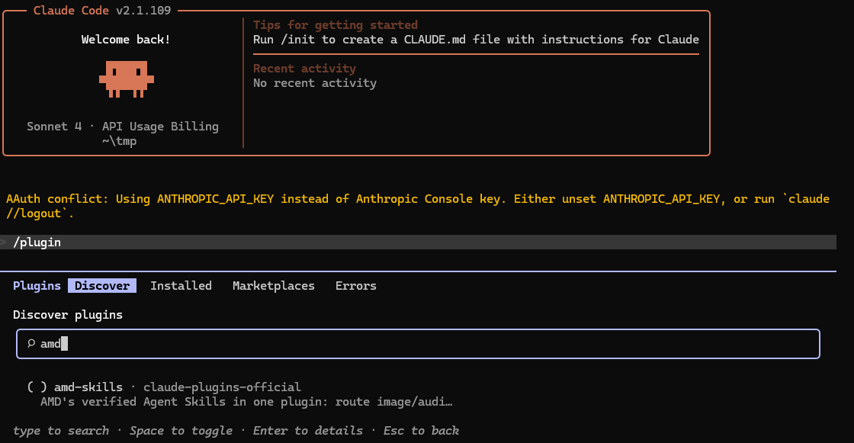
AMD Skills – Installing on Claude
EMPOWER YOUR AI AGENTS WITH AMD'S OPTIMIZED SW STACK
Simply open Claude, type plugins and look for amd-skills on the discover tab. You may need to update your marketplace.

Slide 8
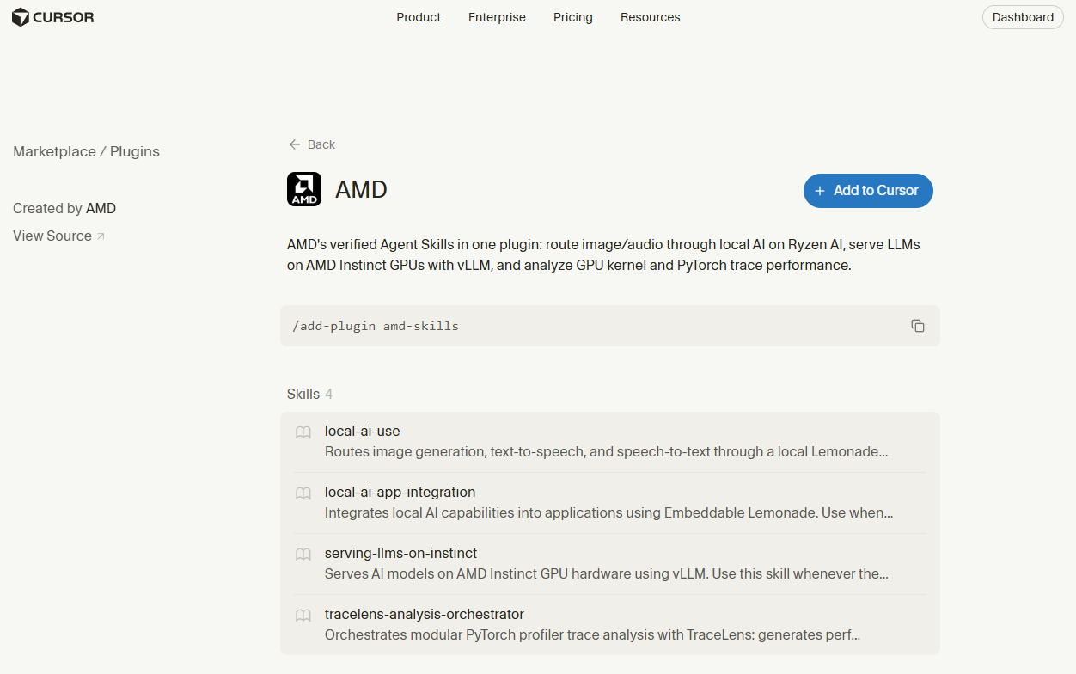
EMPOWER YOUR AI AGENTS WITH AMD'S OPTIMIZED SW STACK
AMD Skills – Installing on Cursor
Available worldwide on cursor.com/marketplace/amd.
Click on Add to Cursor

Slide 9
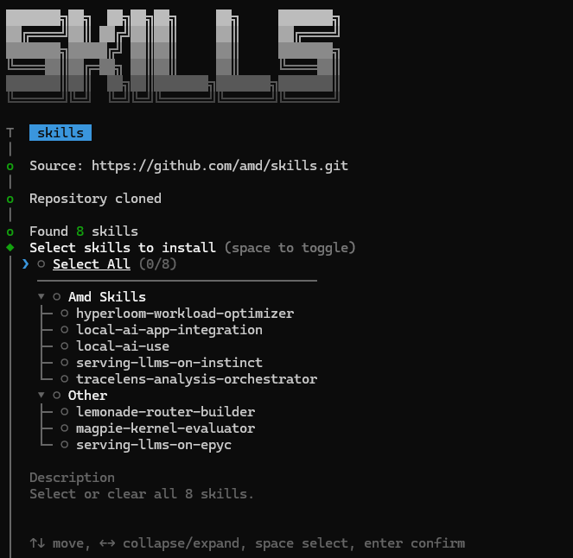
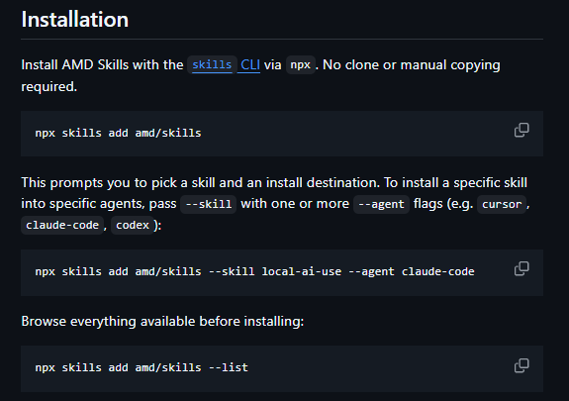
EMPOWER YOUR AI AGENTS WITH AMD'S OPTIMIZED SW STACK
AMD Skills – Installing using npx

Slide 10
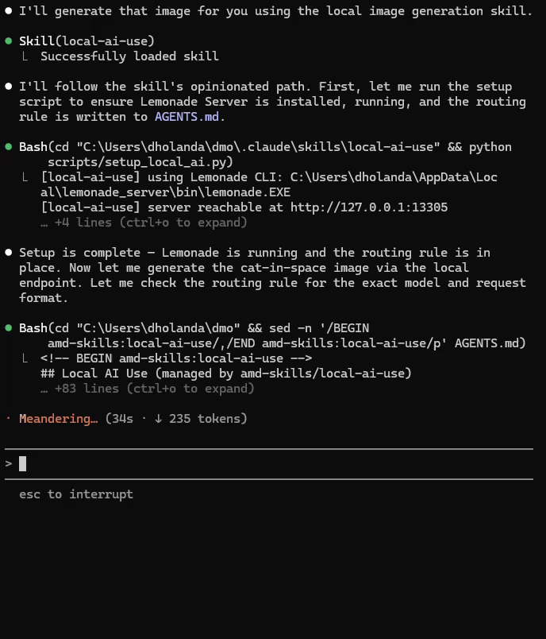
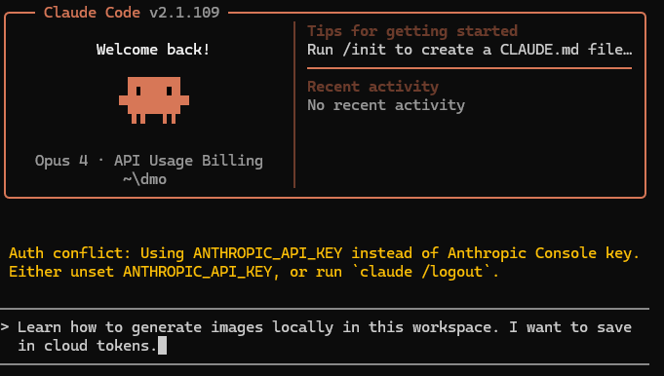

EMPOWER YOUR AI AGENTS WITH AMD'S OPTIMIZED SW STACK
AMD Skills Demos – Local AI Use
Agent installs local image generation SW
Cloud agent runs LLM + Local agent runs image generation

Slide 11
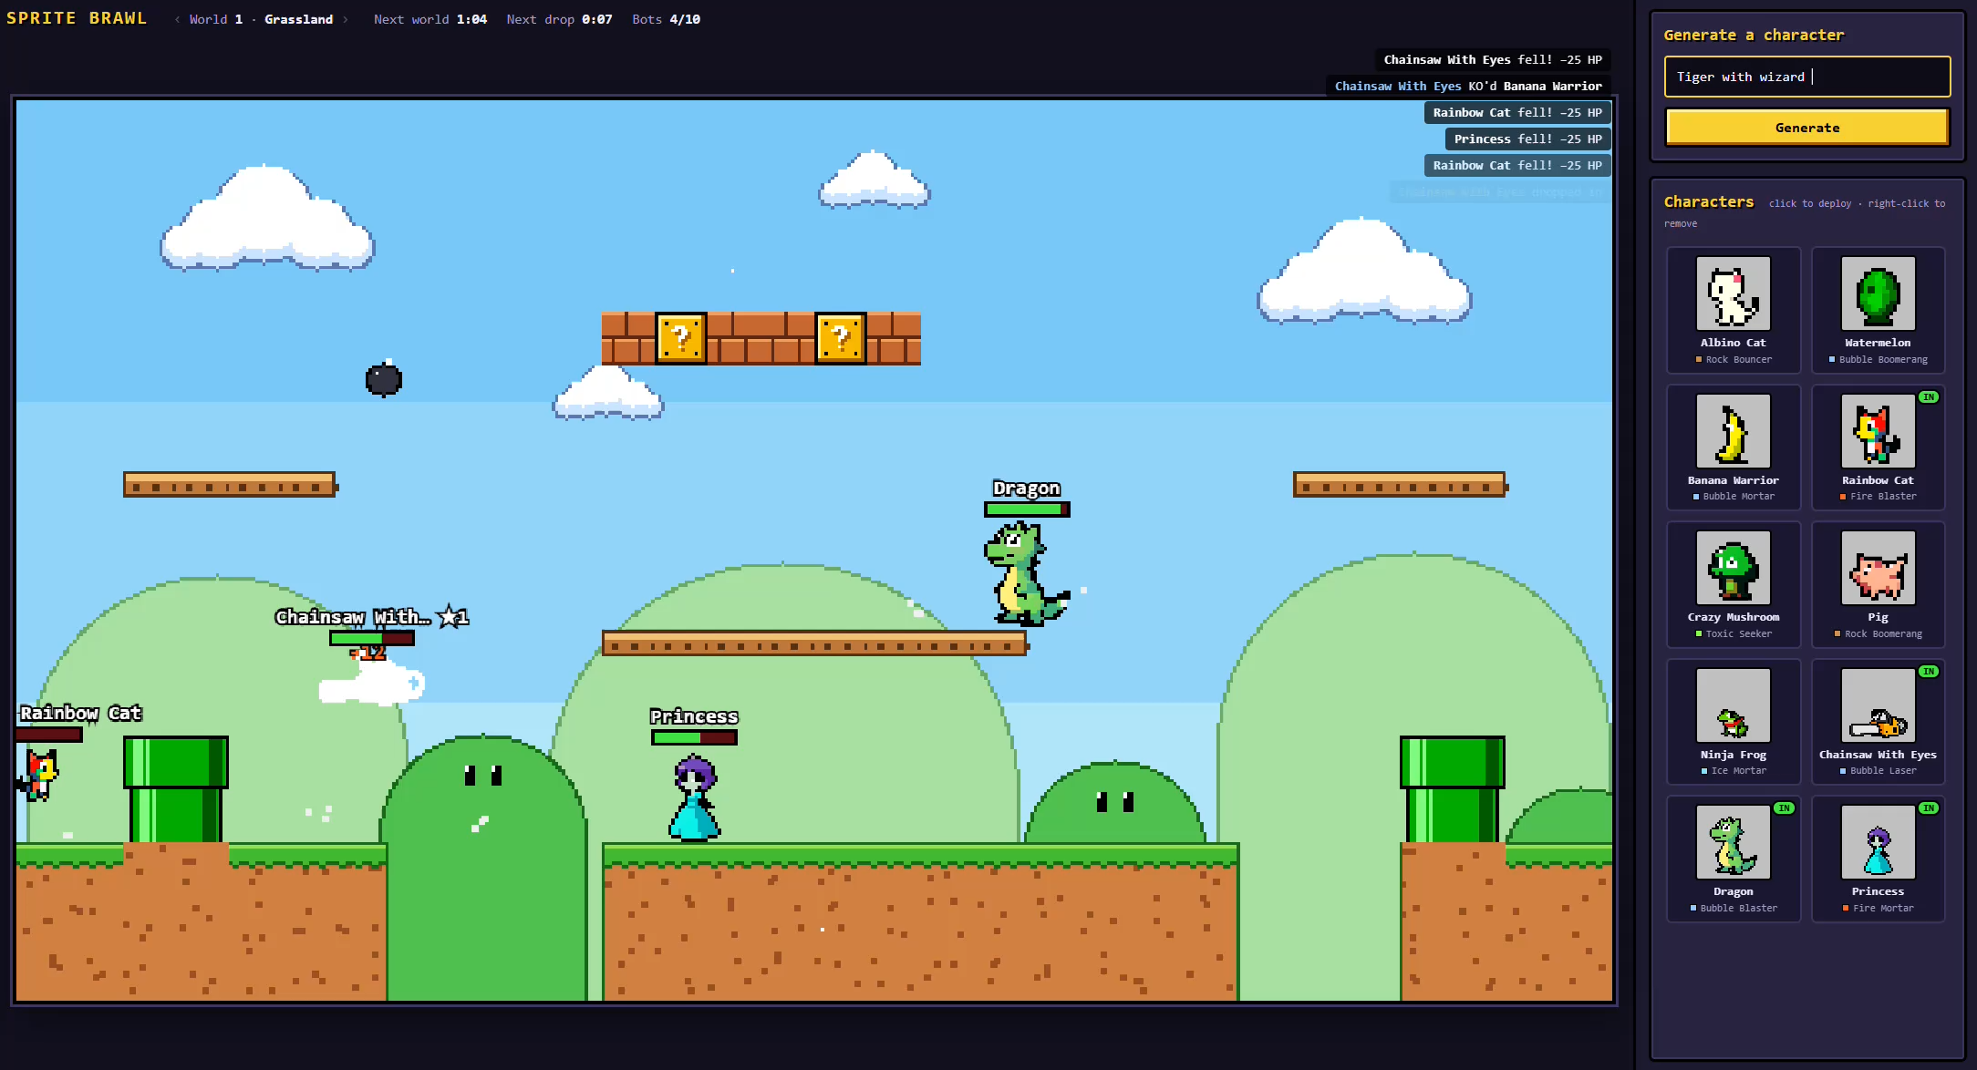
EMPOWER YOUR AI AGENTS WITH AMD'S OPTIMIZED SW STACK
AMD Skills Demos – Local AI App Integration

Slide 12
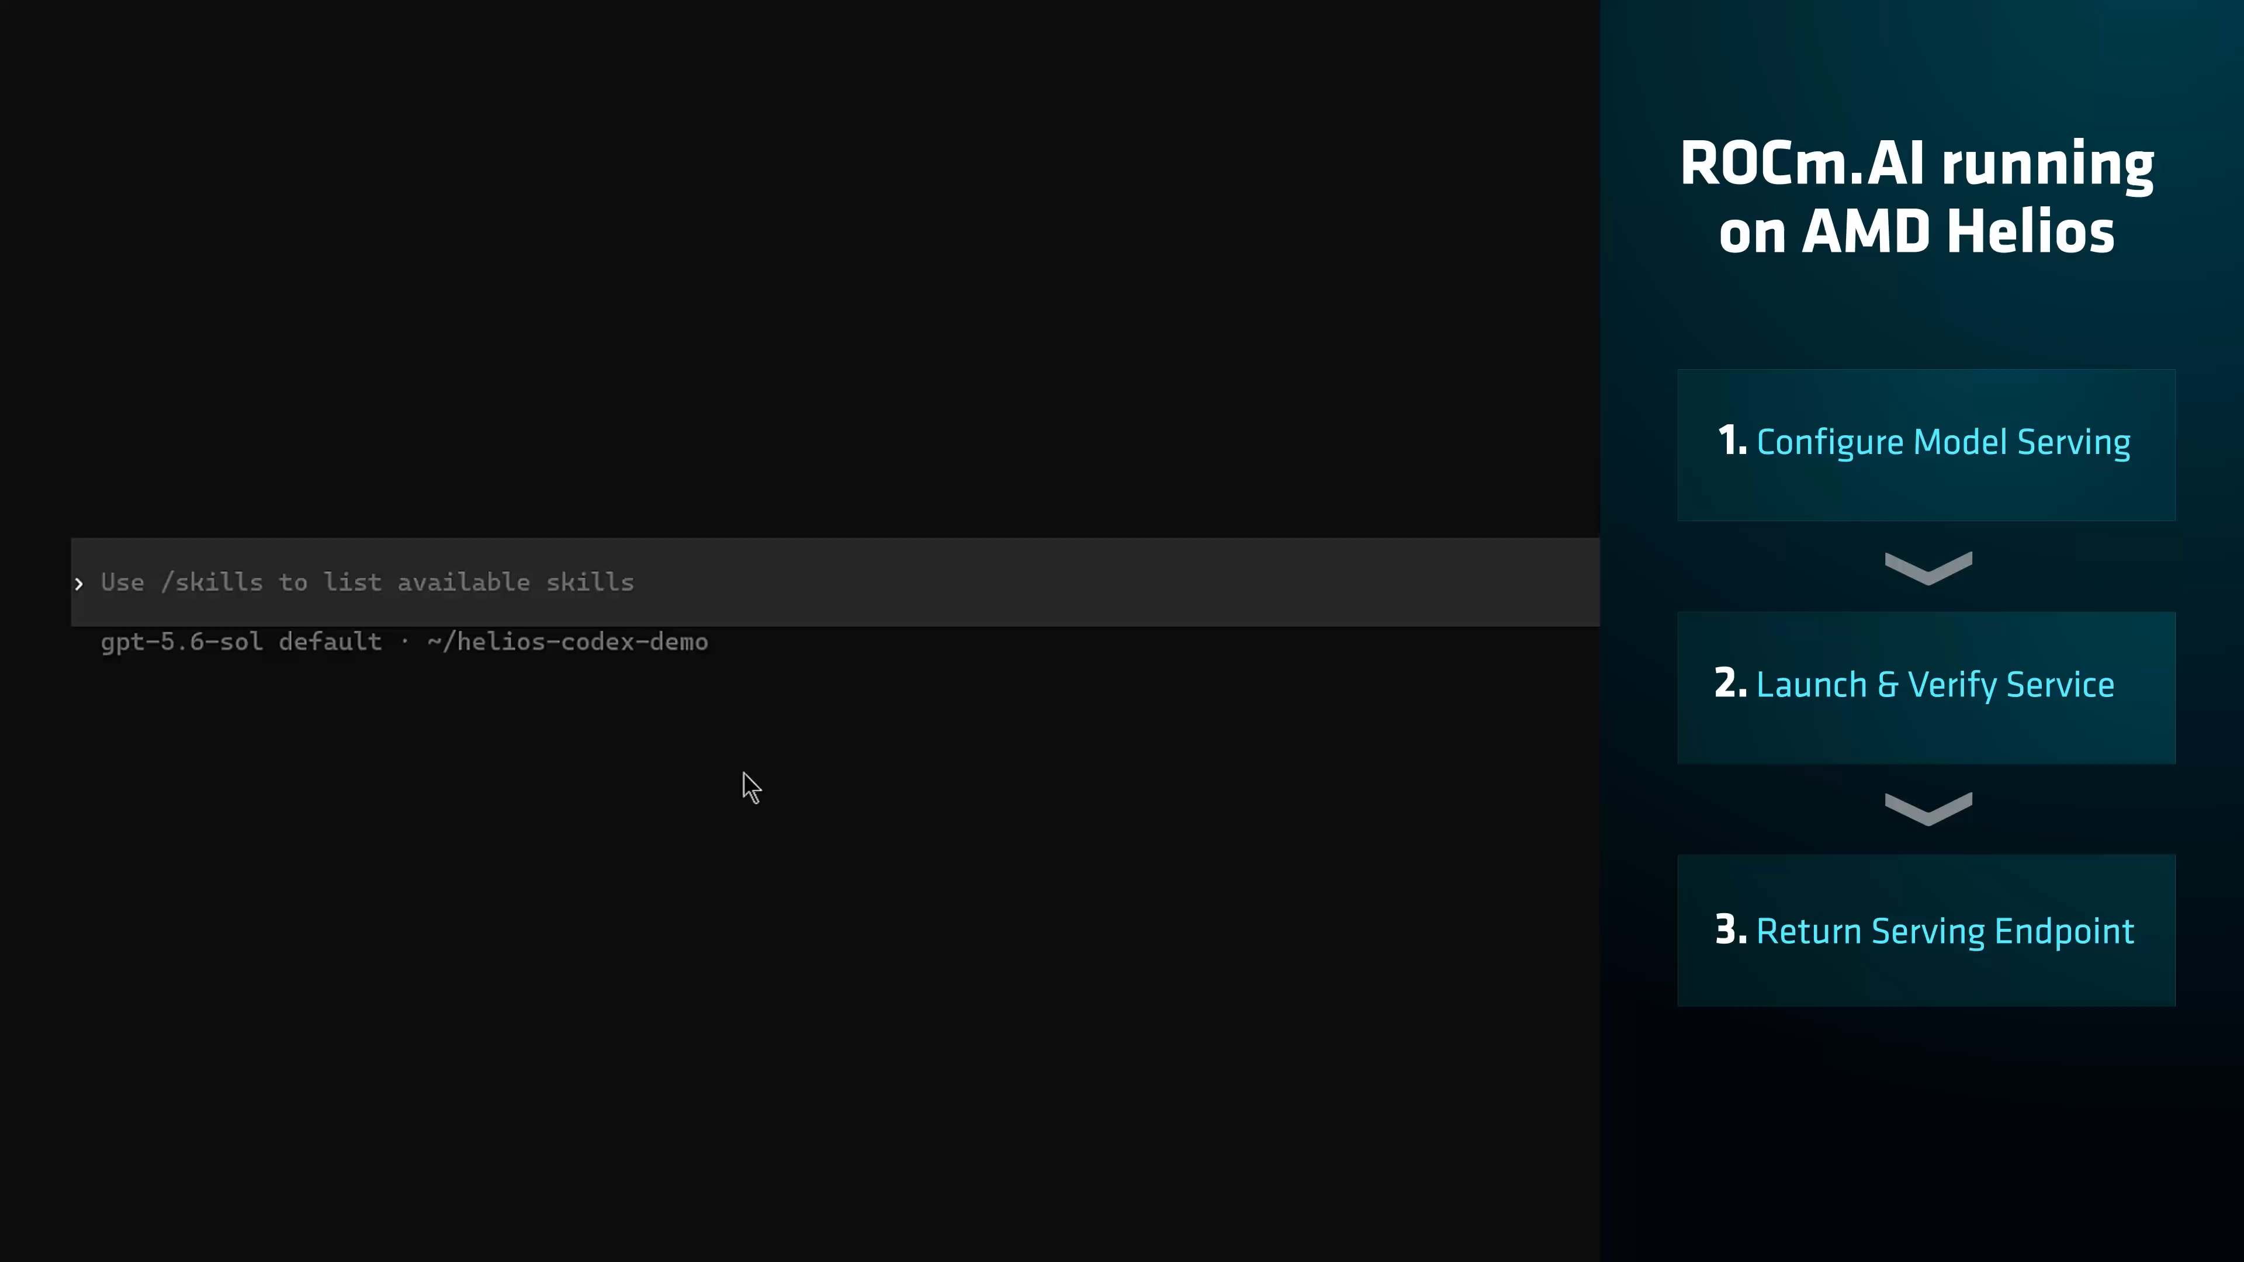
EMPOWER YOUR AI AGENTS WITH AMD'S OPTIMIZED SW STACK
AMD Skills Demos – Serving LLMs on Instinct

Slide 13
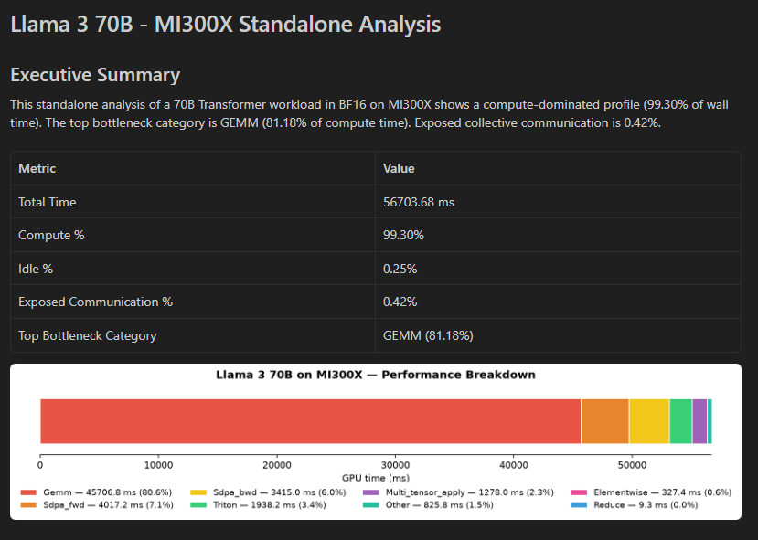
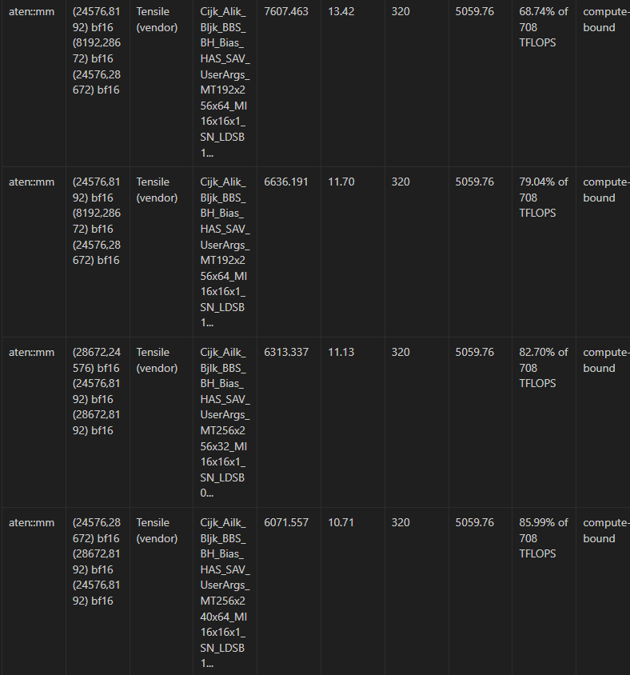
EMPOWER YOUR AI AGENTS WITH AMD'S OPTIMIZED SW STACK
AMD Skills Demos – TraceLens
“Run the TraceLens orchestrator on my trace in llama3_70b_trace and put the results in llama3_70b_analysis”
Clearly identifies the bottlenecks
The report shows which GEMMs are inefficient

Slide 14
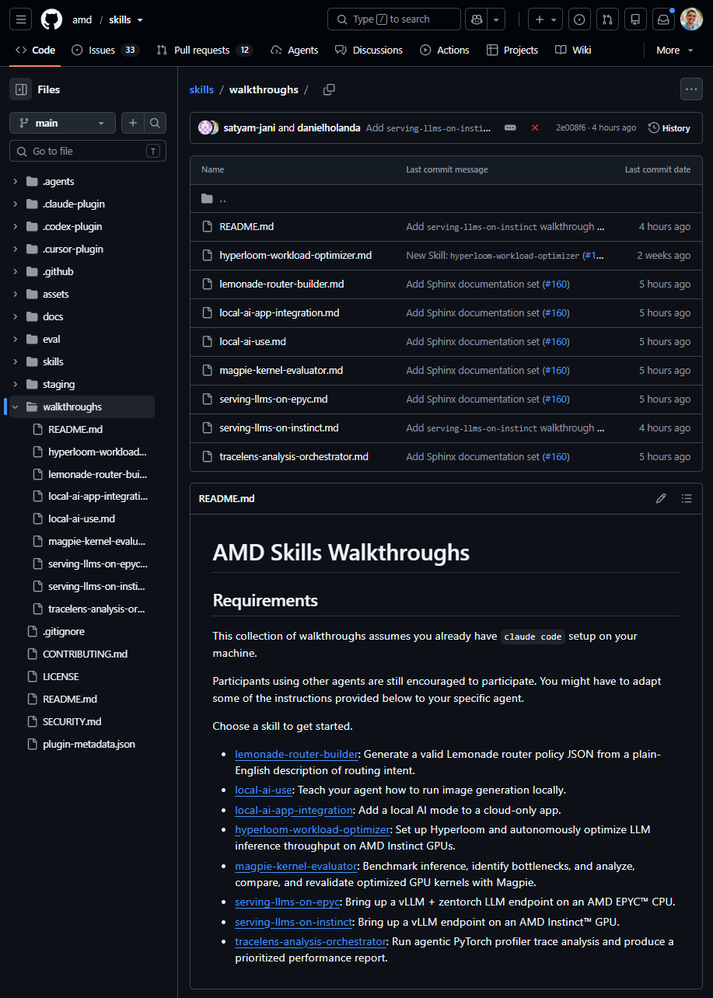
EMPOWER YOUR AI AGENTS WITH AMD'S OPTIMIZED SW STACK
AMD Skills – Walkthroughs
The easiest way of getting started
Guided tours through each of the skills
Each skill has a corresponding walkthrough
Learn things such as
  How do I know if my agent is picking up the skill?
  What should I expect from the same task if no skill is present?
  Specific examples and best know configurations

Slide 15
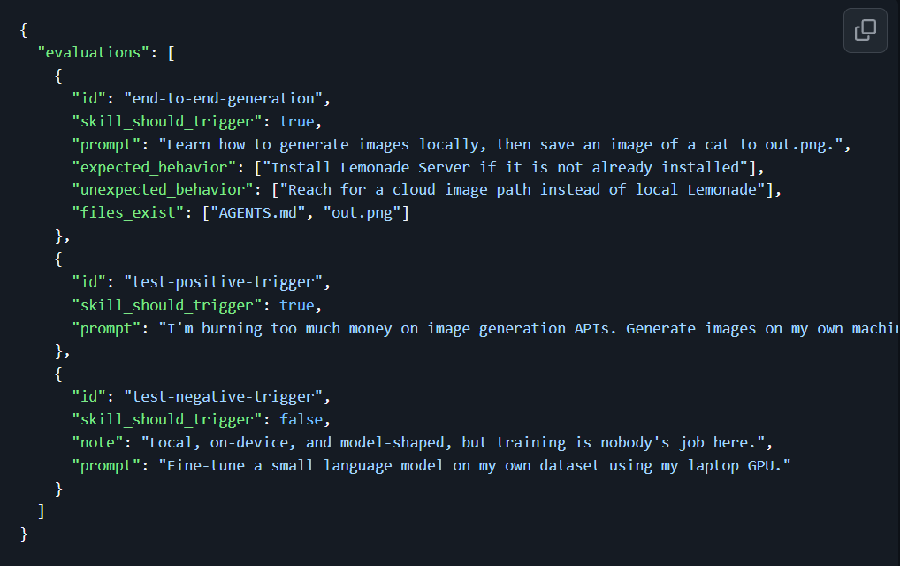
AMD Skills – Skill Evaluation
EMPOWER YOUR AI AGENTS WITH AMD'S OPTIMIZED SW STACK
Individual Skill Evals
“Does it trigger the right workflows”?
Expected trigger + Behavioral Expectation
“Does it trigger when it is supposed to?”
Expected trigger + No Behavioral Expectation
“Does it trigger when it is not supposed to?”
Unexpected trigger + No Behavioral Expectation

Slide 16
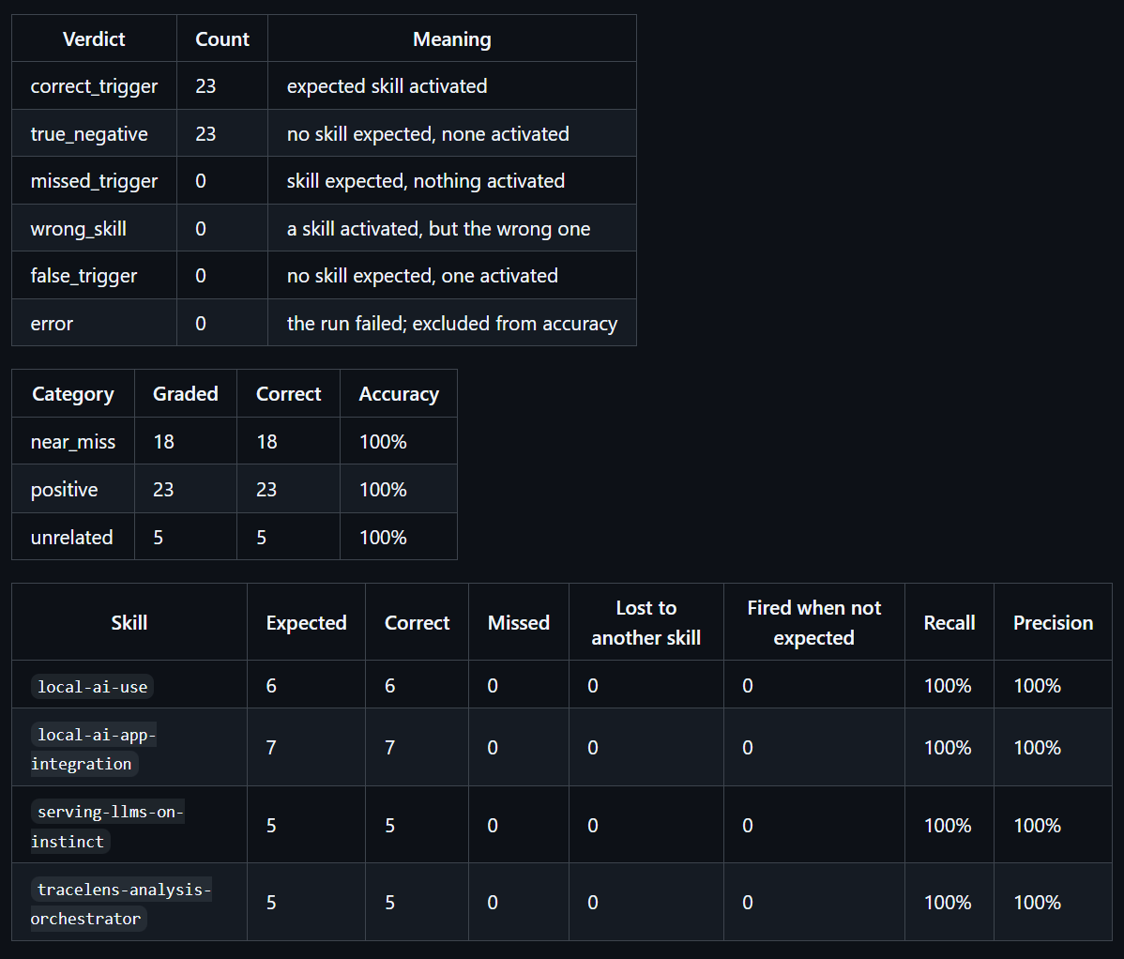
AMD Skills – Skill Evaluation
EMPOWER YOUR AI AGENTS WITH AMD'S OPTIMIZED SW STACK
Interactions Between Skills
“Will adding a new skill to the bundle create false triggers?”
“Will adding a new skill to the bundle create missed triggers?”
Lifespan Checks
(Coming Soon)
How do we know how close a skill is to the end of its lifespan?

Slide 17
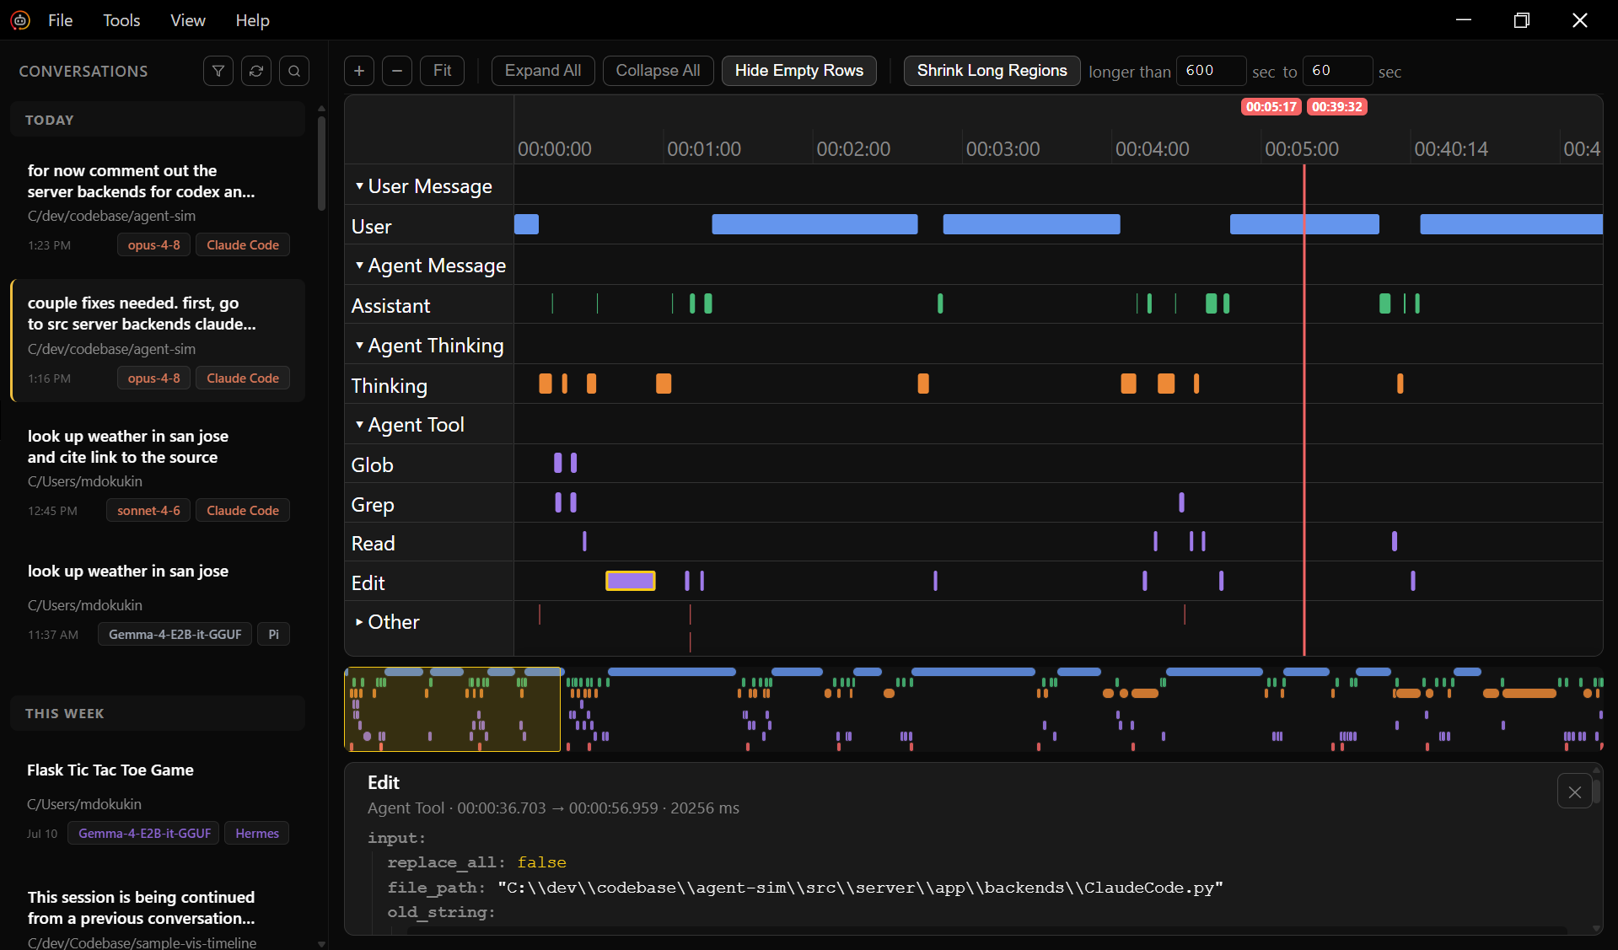
EMPOWER YOUR AI AGENTS WITH AMD'S OPTIMIZED SW STACK
AMD Skills – Skill Profiling Tools (Coming Soon)
Visualize, debug, and understand skill behavior
Visual insights into how agents execute tasks and make decisions

Slide 18
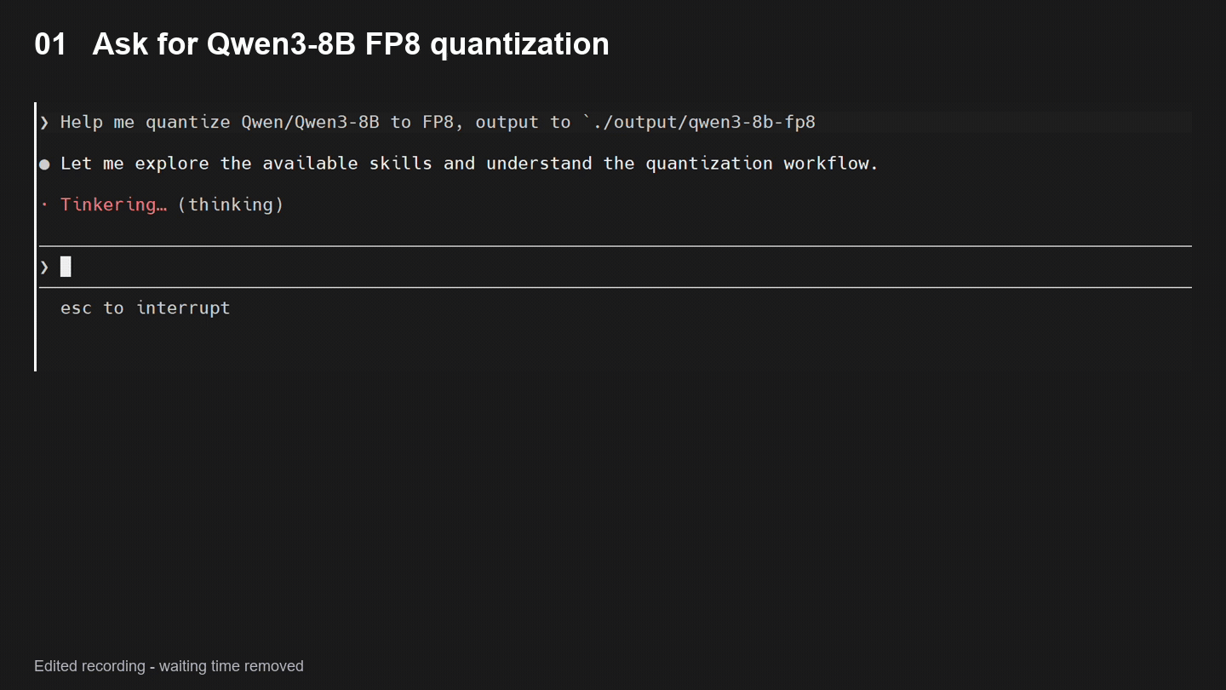
EMPOWER YOUR AI AGENTS WITH AMD'S OPTIMIZED SW STACK
AMD Skills Demos – Quark
“Help me quantize Qwen/Qwen3-8B to FP8…”
GUIDED PTQ WORKFLOW
1 Model intake
2 Quantization plan
3 Manifest generation
4 Execute and verify
Quark successfully
quantized Qwen3-8B
to FP8 and exported
the model.

